Slide 1
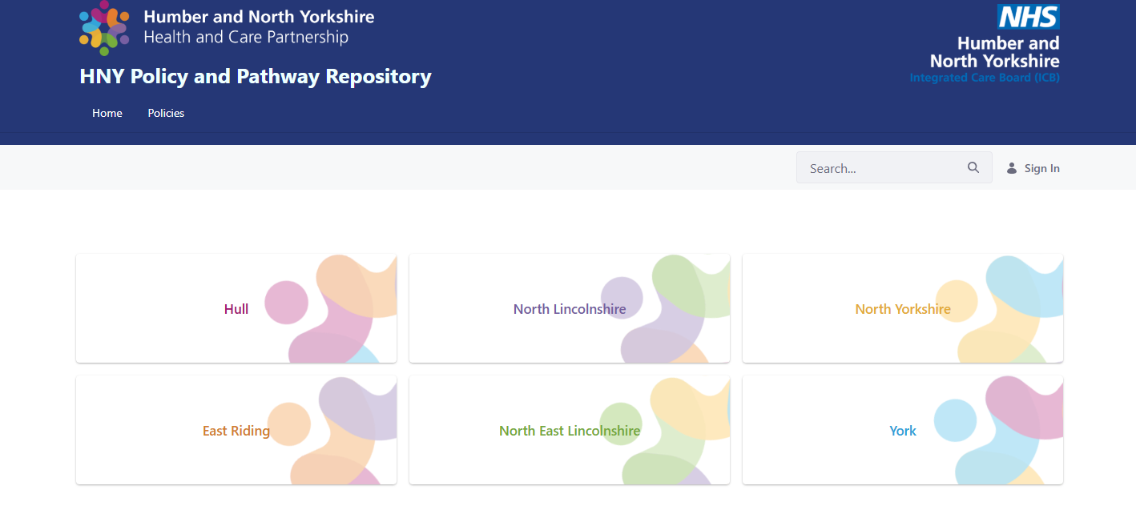
PATHWAY AND POLICY RESPOSITORY (PPR)
INTRODUCTION
Referrers across primary care, community services, and secondary care face challenges in accessing up-to-date clinical commissioning policies and clinical pathways. The PPR provides referrers across Humber and North Yorkshire with easy access to policies and pathways. The PPR is a clinical web-based platform for sharing policy and pathway information to support referral and decision-making. The site is organised by Place, specialty, policy, and pathway. Designed for clinical users; with a team that can upload and update content to keep information current.
COMMUNICATION & ENGAGEMENT
The PPR can be accessed via the following link:
Home - HNY Policy and Pathway Repository
The PPR addresses a critical gap in clinical referral support by offering a centralised, accessible, and user-driven repository. It is anticipated that implementation will improve referral accuracy, patient experience, and health system efficiency across the integrated care system. The PPR will fully replace the existing York RSS site and the Hull and East Riding Pathway Information Portal. To ensure a smooth transition, we will provide regular updates to colleagues in Primary Care and clear communications on the current sites, directing users to the new PPR and explaining how to access it.
If you have any questions or queries regarding the PPR please contact our central mailbox - hnyicb.ppr@nhs.net
NEXT STEPS
North Yorkshire Launch: Finalise implementation and go live in North Yorkshire.
Stakeholder Engagement: Distribute key information to ICS partners in October to ensure awareness and adoption.
Pathway Review & Harmonisation: Continue collaborative work through the Clinical Effectiveness Unit to align and streamline pathways across Humber and North Yorkshire.
User Feedback: Collect and analyse feedback from current users to inform future enhancements and support ongoing improvement.
If you would like to be involved with this work, please contact the ICBs CEU at hnyicb.clinicaleffectivenessunit@nhs.net

