Slide 1



Policy and Pathway Repository
The purpose of the Policy and Pathway Repository (PPR) is to improve access to consistent, centralised clinical commissioning policies and pathway information for referrers across the region.
Background:
Referrers across primary care, community services, and secondary care face challenges in accessing up-to-date, consistent referral clinical commissioning policies and clinical pathways. The current lack of a centralised, accessible source results in misdirected or inappropriate referrals, reducing clinical and operational efficiency and impacting patient experience.
Overview of the Policy & Pathway Repository (PPR):
The PPR is a clinical web-based platform for sharing policy and pathway information to support referral and decision-making.
Organised by Place, specialty, policy, and pathway.
Designed for clinical users; with a team that can upload and update content to keep information current.
Key Benefits:
Centralised Access: A single source of truth for clinical commissioning policies and pathways, accessible across all geographies.
Improved Decision-Making: Timely access to clear and consistent information supports accurate referrals and enhances patient outcomes.
Operational Efficiency: Reduces inappropriate referrals, saves clinician time, and improves service utilisation.
User-Focused Design: Searchable and structured for ease of use, including for locum clinicians.
Conclusion: The PPR addresses a critical gap in clinical referral support by offering a centralised, accessible, and user-driven repository. Its implementation will improve referral accuracy, patient experience, and health system efficiency across the integrated care system.
The PPR can be found at the following address - Home - HNY Policy and Pathway Repository

Slide 2
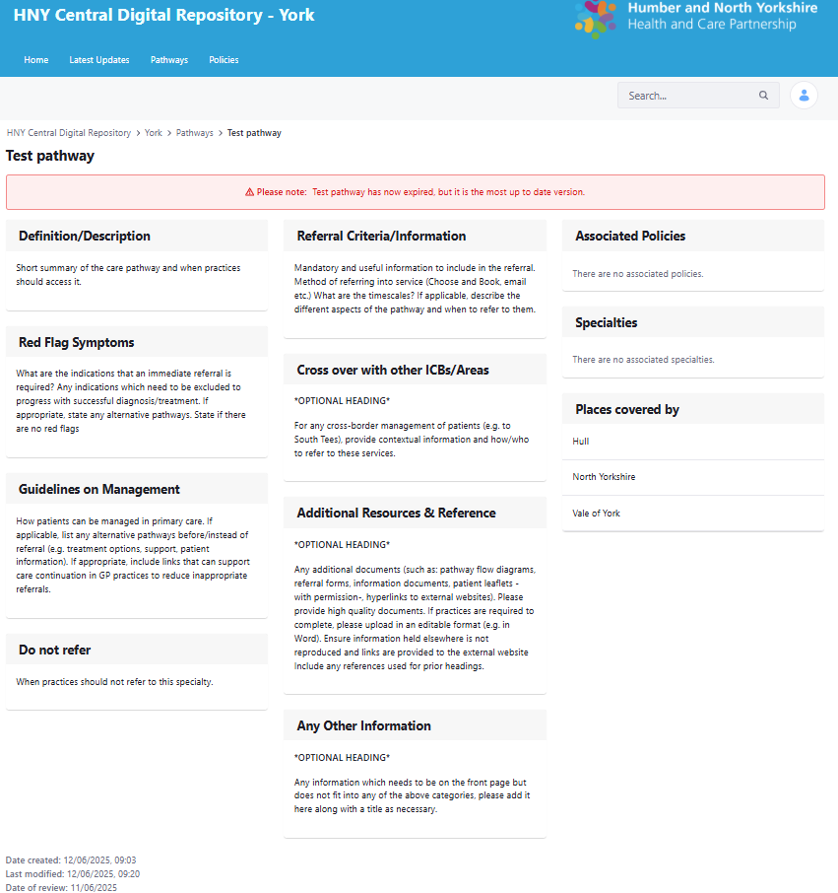
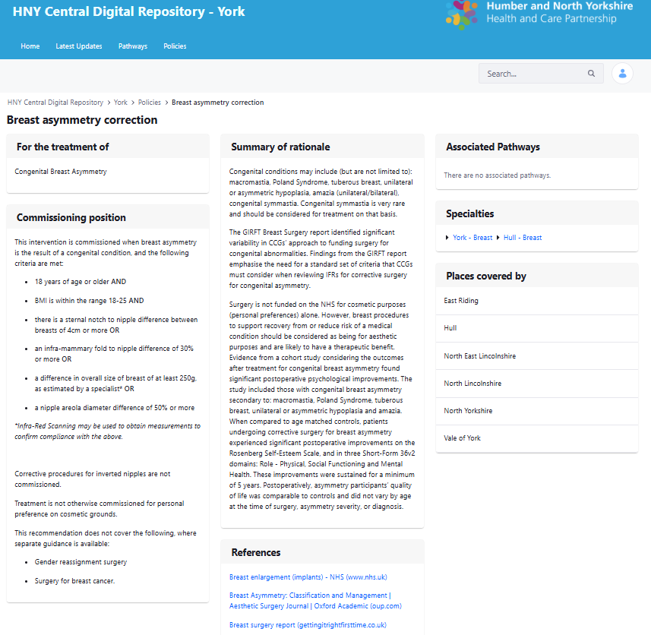
The below shows examples of the pages within the repository
Pathway page:
Policy page:

